Slide 1

The Innovation Lab
Summer Internship 2022
Mentor-Intern Meeting 1
VAAYUBHOOMI
Mentors: Shayak Bhadraray Harshith Kumar MB
T Vijay Prashant
Interns: Pramuk MP
Samuel Thomas
Sriram Radhakrishna

Slide 2
Problem Statement
Networked robots for reconnaissance over open environments
Localization of objects in known and unknown terrains
Recon based network autonomous system
USP: Communication between UAV and UGV
Helps overcome disadvantage of either system
<Project Name>

Slide 3

Proposed Approach
We intend to execute this project in two phases : Phase 1 is a simulation of the UAV and Phase 2 is an implementation of an autonomous system with the UGV.
Phase 1 UAV - Patrol bot that works in a specified area
Detects specific targets while on predetermined patrol path
Hones in on the same with a freshly generated path
After target acquisition by the sensors, path planning occurs along with transmission of the pose of the target to UGV. Location saved as a node.
Simulation occurs in ROS + Gazebo
Phase 2 UGV - Ground vehicle
Pose of the target acquired, path planned
Cameras and sensors integrated for autonomous capabilities
Potential Hardware aspects explored contingent on time
<Project Name>

Slide 4
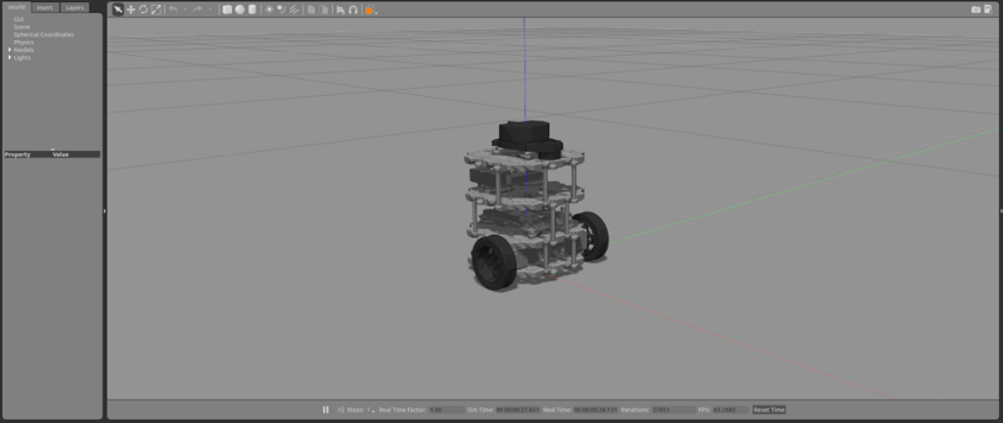
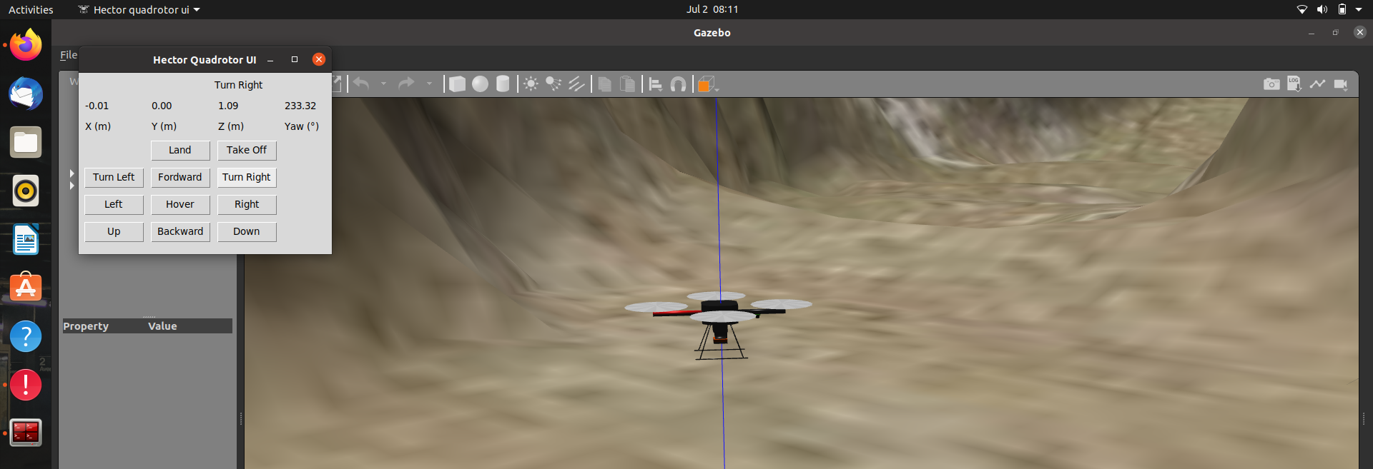
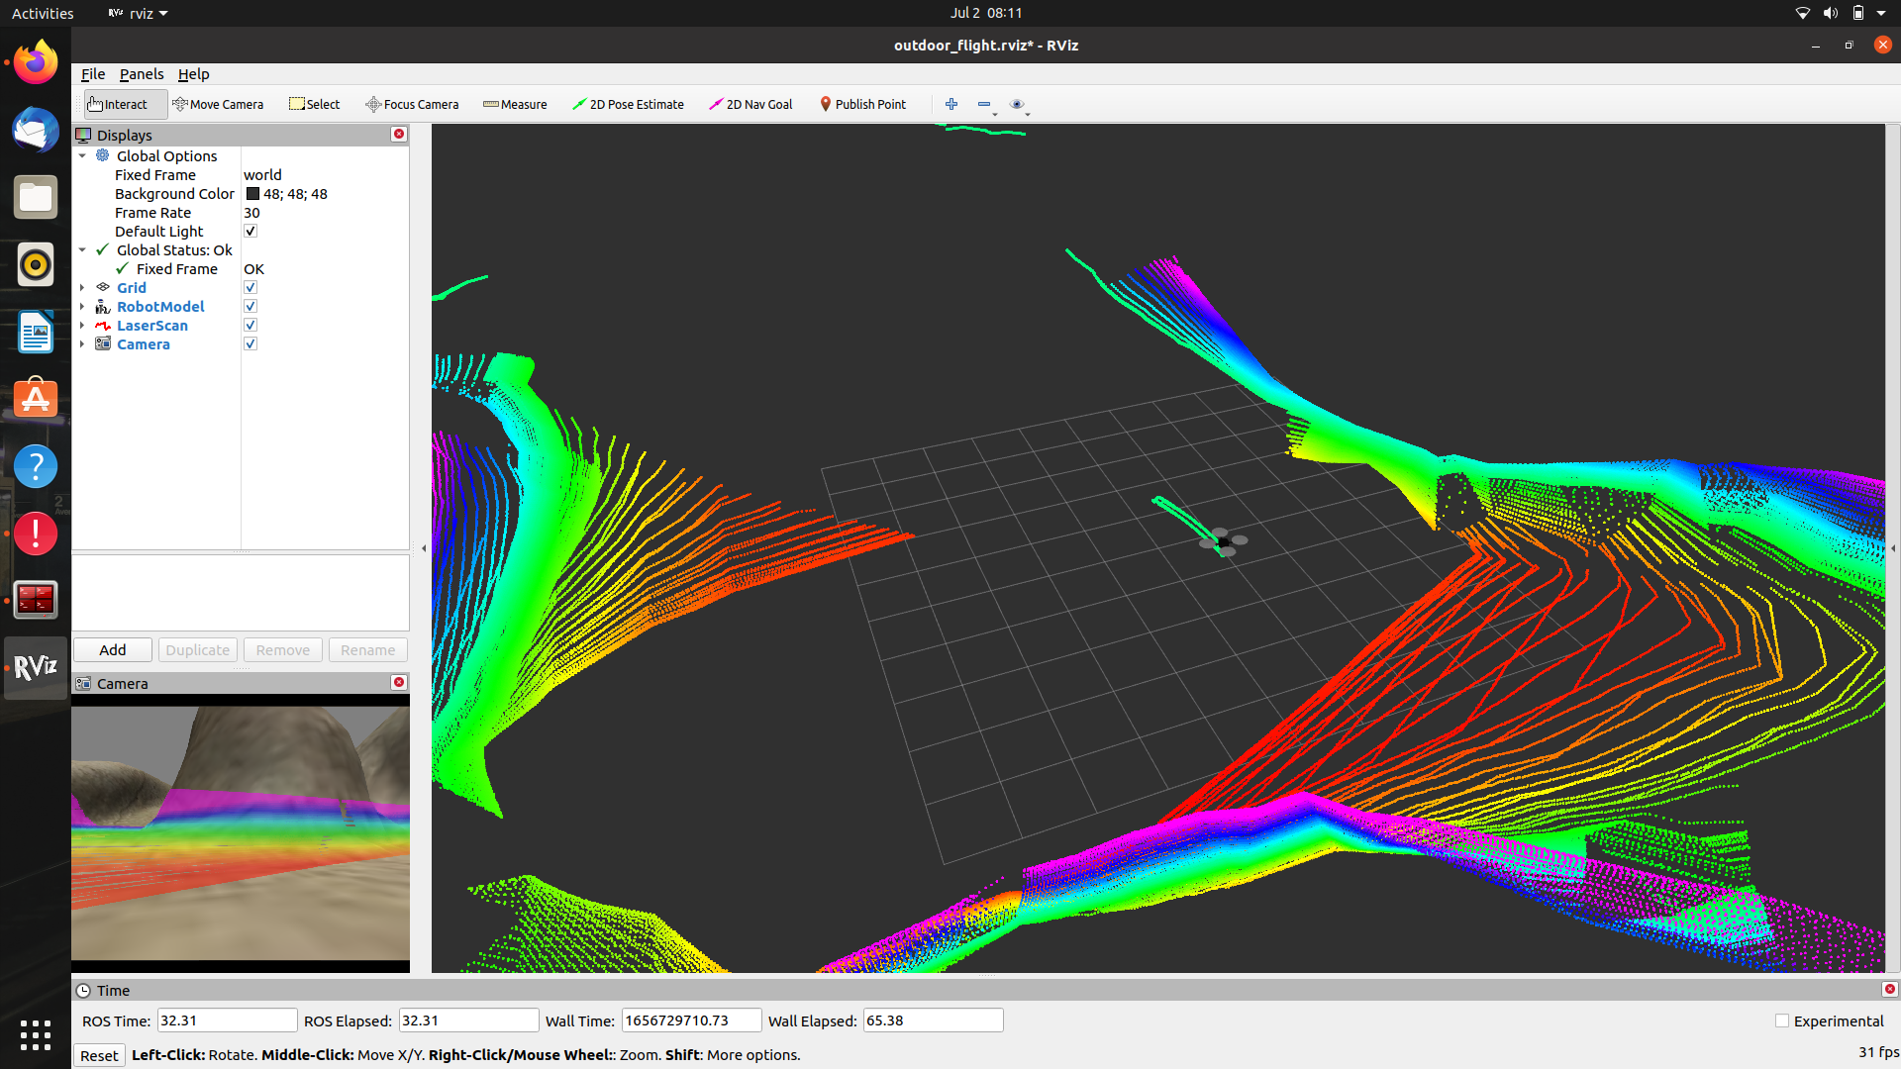
Course correction - Husky has been abandoned for Turtlebot3 as the newer versions don’t come with the necessary sensors.
Dealt with a few launch errors and other bug fixes (mostly due to VM usage, which required dual booting to be fixed)
Simulated Turtlebot3 on gazebo and controlled it using teleop_twist_keyboard.
Simulated Turtlebot3 on gazebo and controlled it using custom nodes.
Simulated hector quadrotor and controlled using teleop_twist_keyboard.
Obtained a video feed and laser scan from turtlebot3 and hector quadrotor on rviz.
Progress + Individual Contributions
<Project Name>

Slide 5
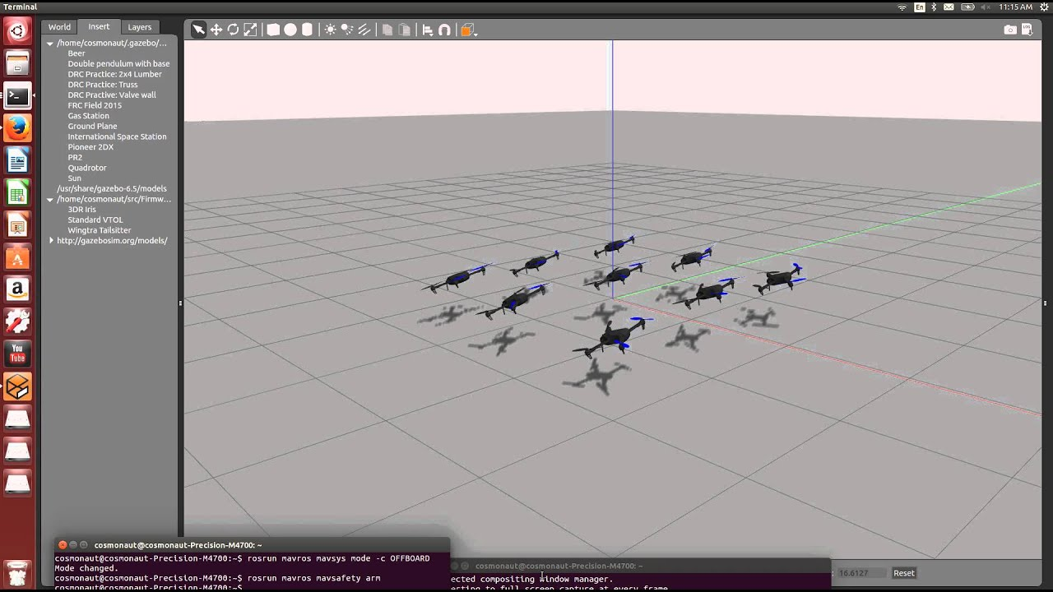
Plan for the next 2 weeks
Obtain a video feed of both robots using CVBridge.
Figure out how to write custom nodes for the UAV -
This will require an understanding of the messages used for communication with the quadrotor
Construct a node to autonomously control the same.
Begin working on simulations for UAV based localization and target detection
This section will involve taking a course on SLAM.
Nodes will be implemented for the UAV to detect the location of a target and autonomously navigate towards it.
<Project Name>

Slide 6
Thank You

